Slide 1
School Wide Reading Program
Every Classroom, every day!

Slide 2
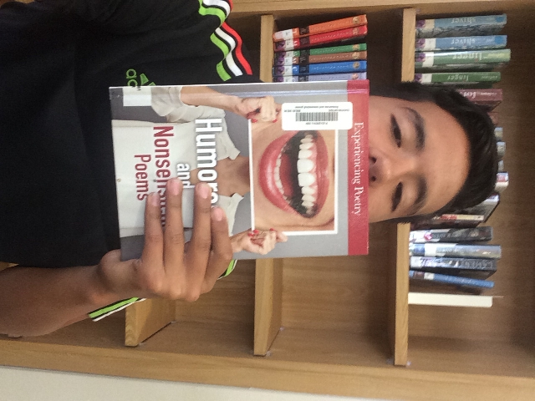
The Why of Reading
Free Reading is linked to…
Establishment of future goals
An Internal locus of control
The ability to empathize
Strong communication skills
The ability to focus
Reading fluency

Slide 3

A little goes a long way!
Students read 10-12 minutes 3 times a week
Students gained 1-3 reading levels during 1 school year
Reimagining Reading: Creating a Classroom Culture that Embraces Independent Choice Reading by Katie Dickerson

Slide 4
Readicide by Kelly Gallagher 2009
The National Assessment of Educational Progress shows that secondary school students are reading significantly below expected levels.
The Alliance for Excellent Education points to 8.7 million secondary students (1 in 4) who are unable to read and comprehend the material in textbooks.
The 2005 ACT College Readiness Benchmark for Reading found that only about half the students tested were ready for college-level reading, and the 2005 scores were the lowest in the decade.
3 thousand students with limited literacy skills drop out of school every day in this country.

Slide 5
How can we NOT make time?
Increases student achievement!
Increases student motivation!
Better writing!
Richer vocabulary!
Increases background knowledge in Social Studies & Science!
2/3 of students who cannot read proficiently by the end of 4th grade will end up in jail or on welfare.
Reading helps you reduce stress, improve memory, sleep better, stave off Alzheimer’s, improve focus & concentration, and be a better communicator & writer.

Slide 6
* 4th period for the 1st 10-12 minutes
- if you have 1st lunch, students will read upon return to class.
- if you have gym, students dress out, read, then start class.
* No more channel one school wide
Reading: When & Where

Slide 7
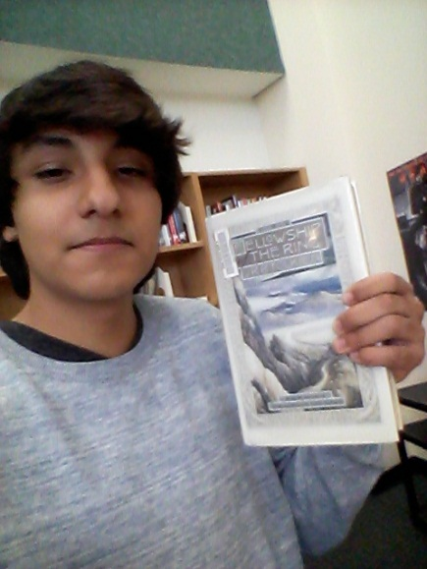
How will students get books?
ELA classes will bring students monthly to library for book checkout
Any class can schedule to come to the library
Half Price Books will give free books to educators
  Clear Lake: 961 NASA Pkwy
  Pearland: 2556 Smith Ranch Rd.
  Rice Village: 2537 University Blvd.
  Westheimer/Montrose: 1011 Westheimer
  The library has discarded magazines for non-ELA classrooms
  Students may use their smartphone or tablet.

Slide 8



What can students read?
Ebooks | Non-traditional Print | Online | Traditional Print
Kindle/Nook | Comic Books | Flipster | Books
Overdrive | Graphic/Manga | News website | Magazines

Slide 9
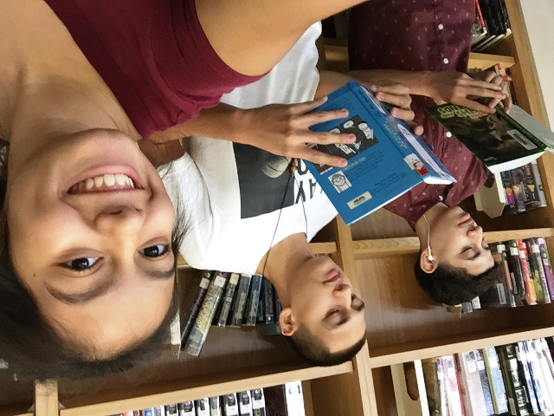
What Students Cannot do…
Social Media: Facebook, Snapchat, Twitter, Tumbler, etc…
Non-news websites
Play games
Watch videos, television, or movies of any kind.

Slide 10
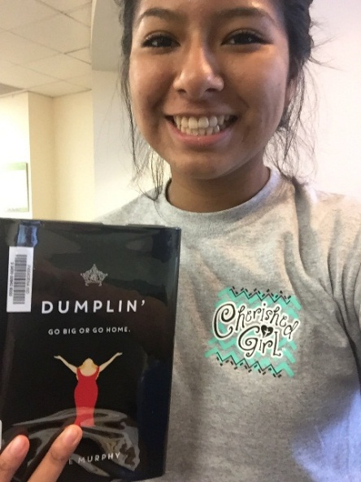
The business of it all!
Week 1:
Instructions

