Slide 1
Going Paperless in the Classroom

Slide 2

Benefits of Going Paperless
Increases organization
Due date is easy to measure
The teacher is in control of the work handed in
Papers are not lost
Increases efficiency
Documents feedback
Increases student
responsibility
Increases relevant
technology skills

Slide 3

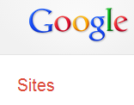





Communication
Teacher website (school related)
Texting tools:
Edmodo.com

Slide 4
Cloud Storage & Class Management

Slide 5


Google Drive
Google Drive: Word processing in the cloud, can be used for collaboration, students create a folder to share with the teacher, teacher creates a folder to share with students
  Benefits
    Can access anywhere on the internet
    Revision history
    No email
    Set permissions
    Can copy documents
    Can share documents
    Also has spreadsheet , presentation
    tools, and forms
    Accessible through apps on devices as well as through
    an application that can be downloaded to a computer.

Slide 6

DropBox.com
Dropbox is a free service that lets you bring your photos, docs, and videos anywhere and share them easily.
Accessible on all devices through apps or an easy to download program in addition to the Internet

Slide 7
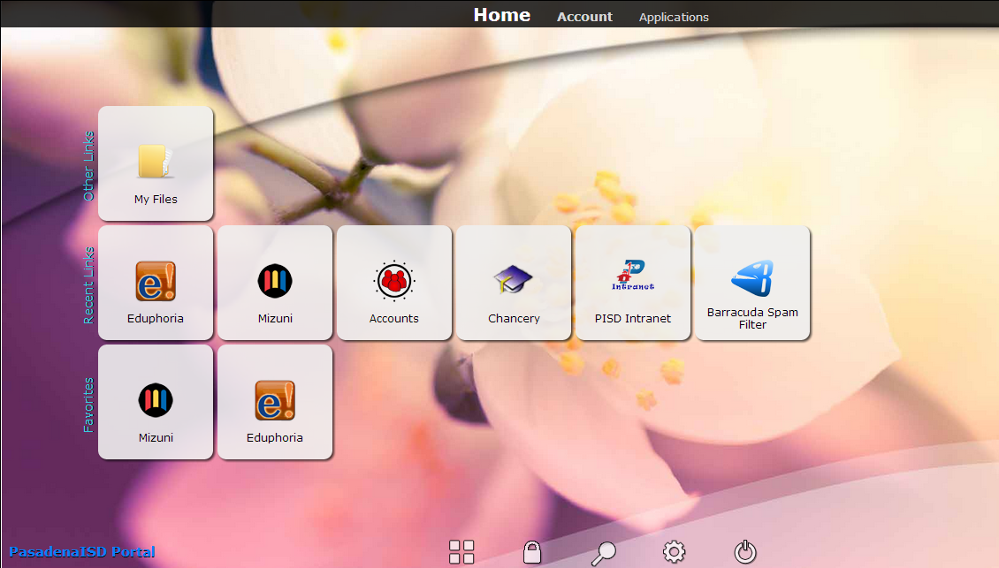
Stoneware
Allows for the sharing of files
Cloud storage
Easy access to resources through tile links

Slide 8
Classroom Management Software
Products:
  LanSchool
  NetSupport
  NeTop Vision
  SMART Sync
Uses:
  Student monitoring
  Sharing of screens and files
  Some allow polling of students
  Remote control of student machines

Slide 9





Online Presentations
Prezi
Google Drive Presentation Tool
Voki
Glogster.com
SlideRocket.com
SlideShare.net

Slide 10









Collaboration
Wikis
Blog

Slide 11
Grading Electronically

Slide 12
Rubrics
RubiStar (http://rubistar.4teachers.org/)
Rubric Maker (http://www.teach-nology.com/web_tools/rubrics/research/)
Attach rubrics to student work that is turned in electronically.

Slide 13
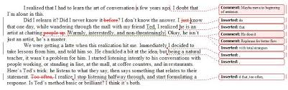
Using Comments
Available in Word and Adobe Acrobat
Instruct students on how you want document saved
Make notes and show corrections using comment features
6 Things you should know about MS Word

Slide 14
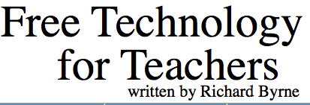
Online Tools
Blackboard Coursesites
Edmodo
Moodle

