Slide 1

eBooks with OverDrive

Slide 2
What Is OverDrive?
OverDrive is an app that lets the user borrow e-books through participating school and public libraries.
Pasadena ISD has purchased e-books and has set up a digital library so that students and any educator in the district can borrow books through this app.
E-books are purchased by individual campuses and district wide through the Libraries and Textbook office. campuses

Slide 3
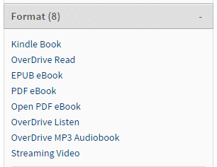
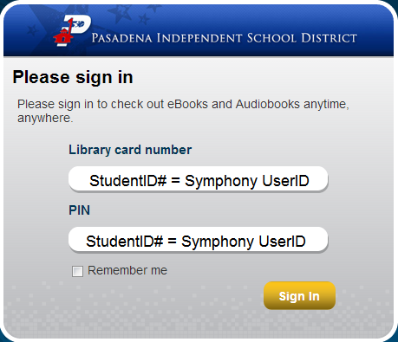
Getting In To OverDrive
http://pasadenaisd.lib.overdrive.com
Or Staff ID #
Unable to do this on a Kindle as of now.

Slide 4
Reading eBooks in OverDrive
Add The OverDrive App
Read in Your Browser
For help go to:
http://pasadenaisd.libguides.com/
Choose the OverDrive Tab
Log in from any web browser to:
https://pasadenatx.libraryreserve.com
Bookmark the website for future use.

Slide 5

Who to Contact:
If you need any additional help see your campus librarian or you are welcome to contact me at any time.
      Thank you!
        Elaine Baker
        Librarian, Pasadena High School
        ebaker@pasadenaisd.org
        (713)740-0310
        X01232

